Slide 1


Chapter 4 The Von Neumann Model
An Hong han@ustc.edu.cn
2019 Fall
Lecture on
Introduction to Computing Systems
（01170401）
School of Computer Science and Technology

Slide 2

Bottom up approach
Now, You are Here.
Transistor

Slide 3

Big Idea #2: How do we get the electrons to do the work?
Application
Algorithm & Data Structure
Language
Software
指令集体系结构 (Machine Architecture, ISA)
Hardware
Microarchiture
Now, You are Here.
Logic and IC
Device
Computer System: Layers of Abstraction
Notes:
3

Slide 4

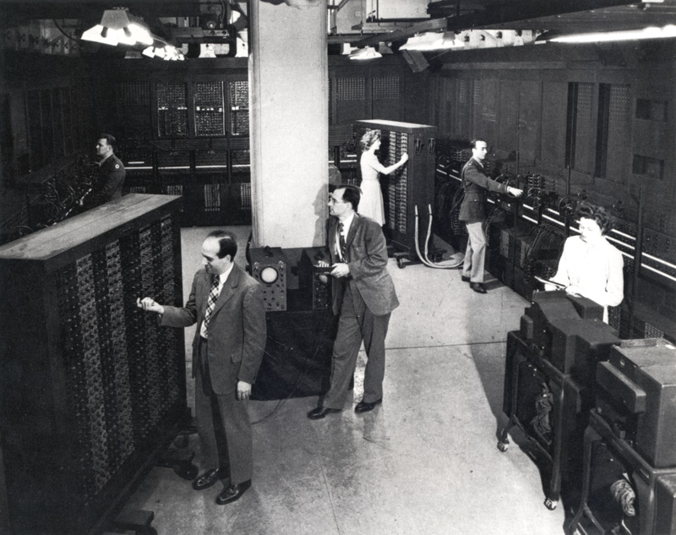
The First Electronic Computers

Slide 5
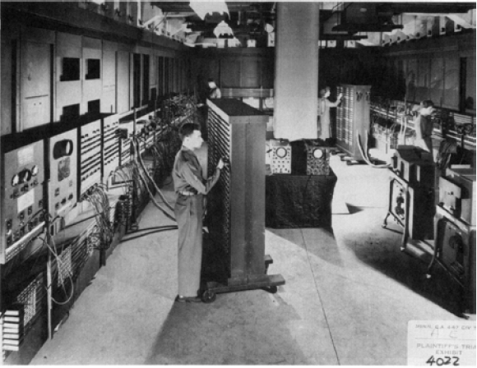
ENIAC - The first electronic computer ,1946年
Programmed by plugboard and switches, time consuming!

Slide 6
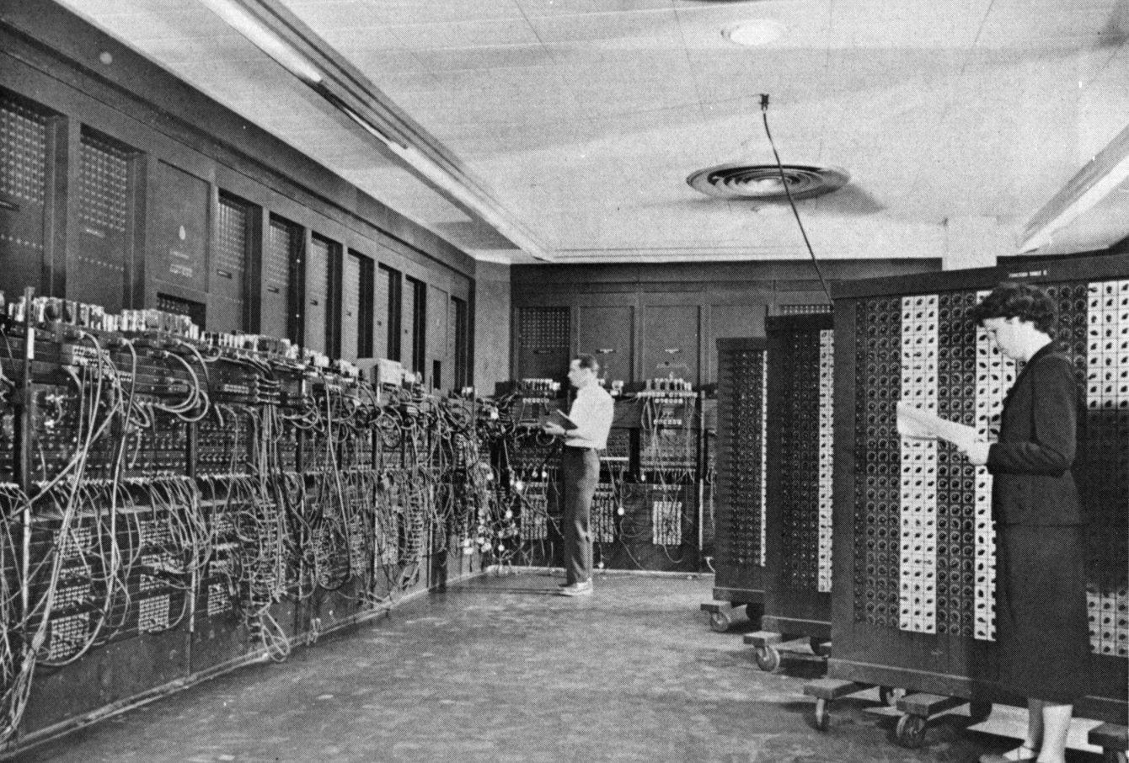
ENIAC - The first electronic computer ,1946年
Changing the program could take days!

Slide 7
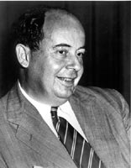
The Origin of the Stored Program
Von Neumann Computer
  1944 – John von Neumann joined ENIAC team. Credited with the idea of storing programs as numbers
  1945 – John von Neumann proposed a stored program computer called EDVAC
  John von Neumann wrote "First Draft of a Report on the EDVAC" in which he outlined the architecture of a stored-program computer.
John von Neumann, c. 1955
Credit: Computer History Museum

Slide 8
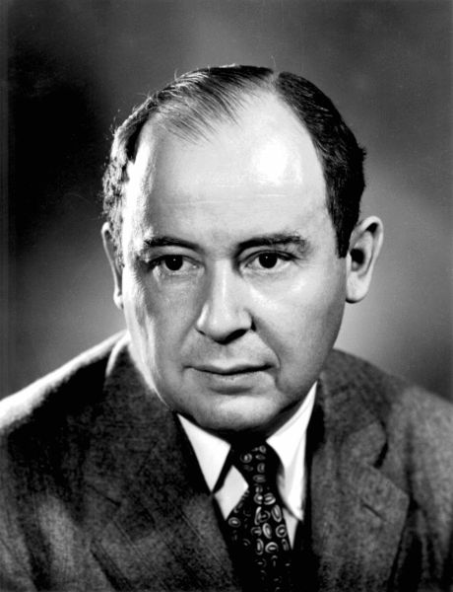
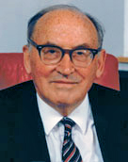
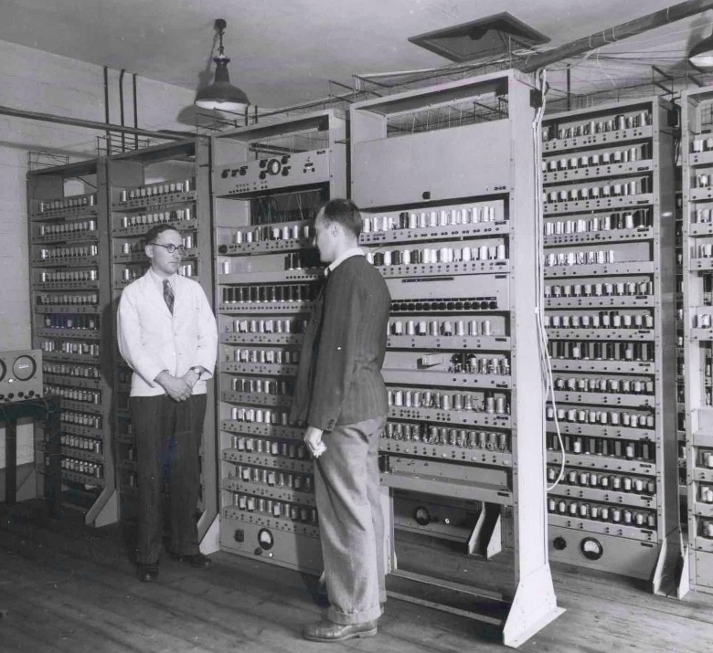
Von Neumann Model(Stored program computer)
Maurice Vincent Wilkes
Von Neumann
EDSAC, University of Cambridge, UK, 1949

Slide 9
The Stored Program Computer Architecture
(von Neumann Architecture)
CPU
控制器
运算器
(ALU)
输入设备
输出设备
存储器
数据流
控制流
Electronic storage of programming information and data eliminated the need for the more clumsy methods of programming, such as punched paper tape — a concept that has characterized mainstream computer development since 1945.

Slide 10
The Stored Program Computer
1944: ENIAC
  Presper Eckert and John Mauchly -- first general electronic computer.
  Hard-wired program -- settings of dials and switches.
1944: Beginnings of EDVAC
  among other improvements, includes program stored in memory
1945: John von Neumann
  wrote a report on the stored program concept,
  known as the First Draft of a Report on EDVAC
  failed to credit designers, ironically still gets credit
The basic structure proposed in the draft became known
as the “von Neumann machine” (or model).
  a memory, containing instructions and data
  a processing unit, for performing arithmetic and logical operations
  a control unit, for interpreting instructions

Slide 11
Von Neumann Model

Slide 12
Memory
0000
0001
0010
0011
0100
0101
0110
1101
1110
1111
00101101
•
•
•
10100010
k x m array of stored bits (k is usually 2^{n})
Address
  unique (n-bit) identifier of location
Contents
  m-bit value stored in location
Basic Operations:
LOAD
  read a value from a memory location
STORE
  write a value to a memory location

Slide 13
Interface to Memory
How does processing unit get data to/from memory?
MAR: Memory Address Register
MDR: Memory Data Register
To read a location (A):
  Write the address (A) into the MAR.
  Send a “read” signal to the memory.
  Read the data from MDR.
To write a value (X) to a location (A):
  Write the data (X) to the MDR.
  Write the address (A) into the MAR.
  Send a “write” signal to the memory.

Slide 14
Processing Unit
Functional Units
  ALU = Arithmetic and Logic Unit
  could have many functional units.
  some of them special-purpose
  (multiply, square root, …)
  LC-3 performs ADD, AND, NOT
Registers
  Small, temporary storage
  Operands and results of functional units
  LC-3 has eight register (R0, …, R7)
Word Size
  number of bits normally processed by ALU in one instruction
  also width of registers
  LC-3 is 16 bits

Slide 15
Input and Output
Devices for getting data into and out of computer memory
Each device has its own interface,
usually a set of registers like the
memory’s MAR and MDR
  LC-3 supports keyboard (input) and console (output)
  keyboard: data register (KBDR) and status register (KBSR)
  console: data register (CRTDR) and status register (CRTSR)
  frame buffer: memory-mapped pixels
Some devices provide both input and output
  disk, network
Program that controls access to a device is
usually called a driver.
Notes:
15

Slide 16
Control Unit
Orchestrates execution of the program
Instruction Register (IR) contains the current instruction.
Program Counter (PC) contains the address
of the next instruction to be executed.
Control unit:
  reads an instruction from memory
    the instruction’s address is in the PC
  interprets the instruction, generating signals
  that tell the other components what to do
    an instruction may take many machine cycles to complete

Slide 17
Instruction Processing（state transtion）
F
Fetch instruction from memory
D
Decode instruction
EA
Evaluate address
OP
Fetch operands from memory
EX
Execute operation
S
Store result
Notes:
17

Slide 18
Instruction
The instruction is the fundamental unit of work.
Specifies two things:
  opcode: operation to be performed
  operands: data/locations to be used for operation
An instruction is encoded as a sequence of bits.
(Just like data!)
  Often, but not always, instructions have a fixed length,
  such as 16 or 32 bits.
  Control unit interprets instruction:
  generates sequence of control signals to carry out operation.
  Operation is either executed completely, or not at all.
A computer’s instructions and their formats is known as its
Instruction Set Architecture (ISA).
Persistent ISA invented by UW grad Gene Amdahl (IBM 360)

Slide 19
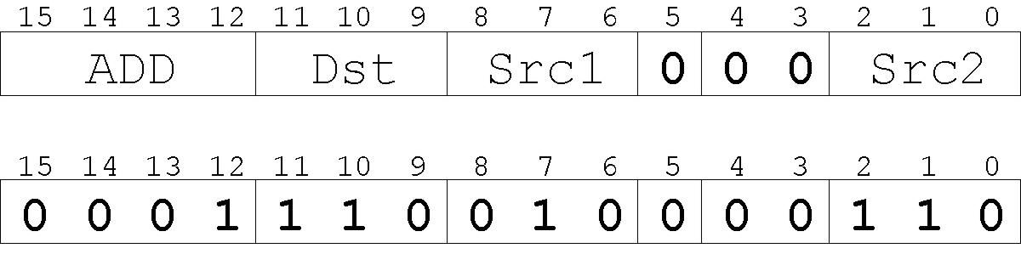
Example: LC-3 ADD Instruction
“Add the contents of R2 to the contents of R6,
and store the result in R6.”
LC-3 has 16-bit instructions.
  Each instruction has a four-bit opcode, bits [15:12].
LC-3 has eight registers (R0-R7) for temporary storage.
  Sources and destination of ADD are registers.

Slide 20
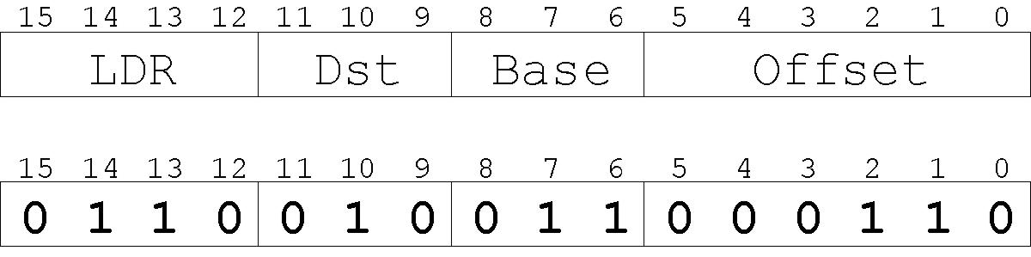
Example: LC-3 LDR Instruction
Load instruction -- reads data from memory
Base + offset mode:
  add offset to base register -- result is memory address
  load from memory address into destination register
“Add the value 6 to the contents of R3 to form a
memory address. Load the contents stored in
that address to R2.”

Slide 21
Instruction Processing: FETCH
F
D
EA
OP
EX
S
Load next instruction (at address stored in PC)
from memory
into Instruction Register (IR).
  Load contents of PC into MAR.
  Send “read” signal to memory.
  Read contents of MDR, store in IR.
Then increment PC, so that it points to
the next instruction in sequence.
  PC becomes PC+1.

Slide 22
Instruction Processing: DECODE
F
D
EA
OP
EX
S
First identify the opcode.
  In LC-3, this is always the first four bits of instruction.
  A 4-to-16 decoder asserts a control line corresponding
  to the desired opcode.
Depending on opcode, identify other operands
from the remaining bits.
  Example:
    for LDR, last six bits is offset
    for ADD, last three bits is source operand #2

Slide 23
Instruction Processing: EVALUATE ADDRESS
F
D
EA
OP
EX
S
For instructions that require memory access,
compute address used for access.
Examples:
  add offset to base register (as in LDR)
  add offset to PC (or to part of PC)
  add offset to zero

Slide 24
Instruction Processing: FETCH OPERANDS
F
D
EA
OP
EX
S
Obtain source operands needed to
perform operation.
Examples:
  load data from memory (LDR)
  read data from register file (ADD)

Slide 25
Instruction Processing: EXECUTE
F
D
EA
OP
EX
S
Perform the operation,
using the source operands.
Examples:
  send operands to ALU and assert ADD signal
  do nothing (e.g., for loads and stores)

Slide 26
Instruction Processing: STORE
F
D
EA
OP
EX
S
Write results to destination.
(register or memory)
Examples:
  result of ADD is placed in destination register
  result of memory load is placed in destination register
  for store instruction, data is stored to memory
    write address to MAR, data to MDR
    assert WRITE signal to memory

Slide 27
Changing the Sequence of Instructions
In the FETCH phase,
we incremented the Program Counter by 1.
What if we don’t want to always execute the instruction
that follows this one?
  examples: loop, if-then, function call
Need special instructions that change the contents
of the PC.
These are called jumps and branches.
  jumps are unconditional -- they always change the PC
  branches are conditional -- they change the PC only if
  some condition is true (e.g., the contents of a register is zero)

Slide 28
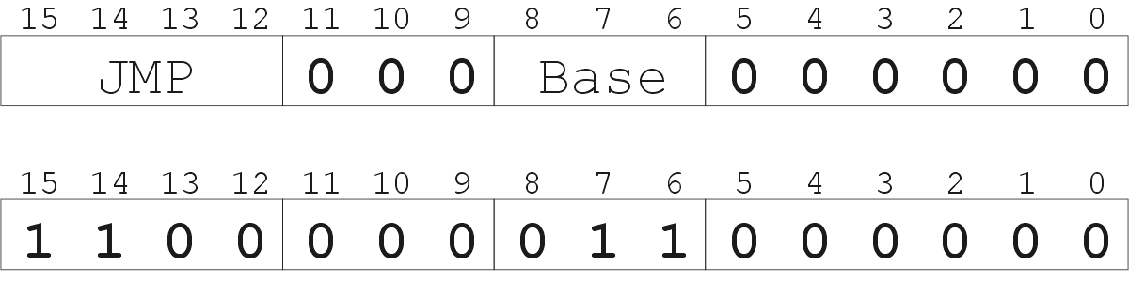
Example: LC-3 JMP Instruction
“Load the contents of R3 into the PC.”
Set the PC to the value contained in a register. This becomes the address of the next instruction to fetch.
Notes:
28

Slide 29
Instruction Processing Summary
Instructions look just like data -- it’s all interpretation.
Three basic kinds of instructions:
  computational instructions (ADD, AND, …)
  data movement instructions (LD, ST, …)
  control instructions (JMP, BRnz, …)
Six basic phases of instruction processing:
F → D → EA → OP → EX → S
  not all phases are needed by every instruction
  phases may take variable number of machine cycles

Slide 30
Driving Force: The Clock
“1”
“0”
Machine
Cycle
time→
The clock is a signal that keeps the control unit moving.
  At each clock “tick,” control unit moves to the next
  machine cycle -- may be next instruction or
  next phase of current instruction.
Clock generator circuit:
  Based on crystal oscillator
  Generates regular sequence of “0” and “1” logic levels
  Clock cycle (or machine cycle) -- rising edge to rising edge

Slide 31
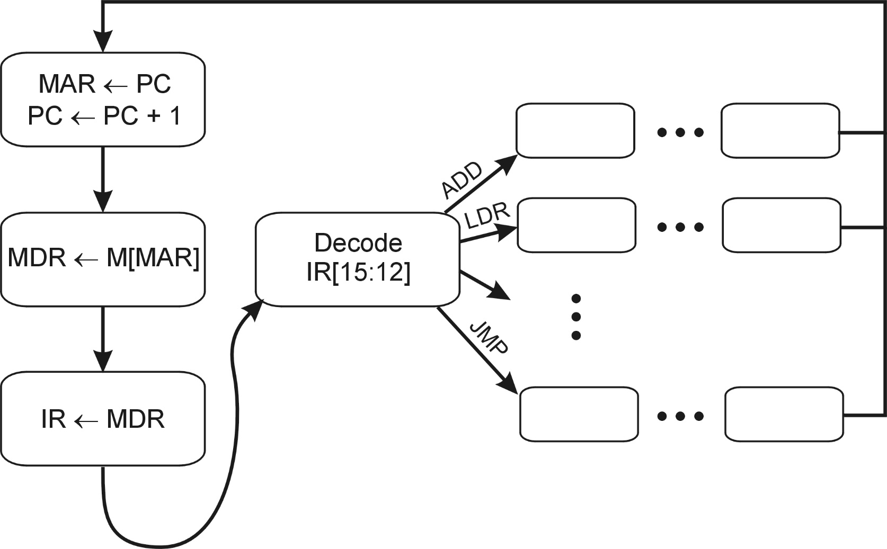
Control Unit State Diagram
The control unit is a state machine. Here is part of a
simplified state diagram for the LC-3:
A more complete state diagram is in Appendix C.
It will be more understandable after Chapter 5.

Slide 32
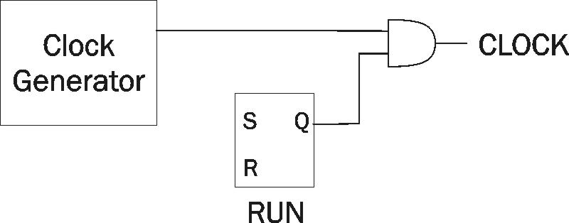
Stopping the Clock
Control unit will repeat instruction processing sequence
as long as clock is running.
  If not processing instructions from your application,
  then it is processing instructions from the Operating System (OS).
  The OS is a special program that manages processor
  and other resources.
To stop the computer:
  AND the clock generator signal with ZERO
  when control unit stops seeing the CLOCK signal, it stops processing

Slide 33
Summary -- Von Neumann Model

Slide 34
Summary -- LC-3 Data Path

